Slide 1
Overview: Internship at GSSPL
Web Development
By Sakshi Patel
CSE 3, 8th Sem
Enrollment No: 180050131542

Slide 2
Garima System Solutions Pvt. Ltd.
About the company:
Garima System Solution (GSS) is young and ambitious Technology Company, who partners with clients to provide Solutions to improve Efficiency, Business Visibility and Analytics.

Slide 3
About the Project
Inventory Management System - Vangi Foods
Vangi Foods is a Gravy Producing Company based in Karamsad, Gujarat.
Inventory management refers to the process by which you track the amount of product you have on your warehouse shelf, in store or sitting with other retailers and distributors.

Slide 4
Project Details
Understanding the flow of the entire Gravy Production
Arranging the web screens according to the process flow
Preparing the database design and documenting it for the Web Design
Designing ERD for the database
Screen Designing
Testing and debugging the created web pages

Slide 5
Technologies Used
HTML/CSS
SQL Management Studio

Slide 6
Basic Flow of the project
Database Design
ERD
UX-Use Case Diagram
Screen Designing
Testing and debugging

Slide 7
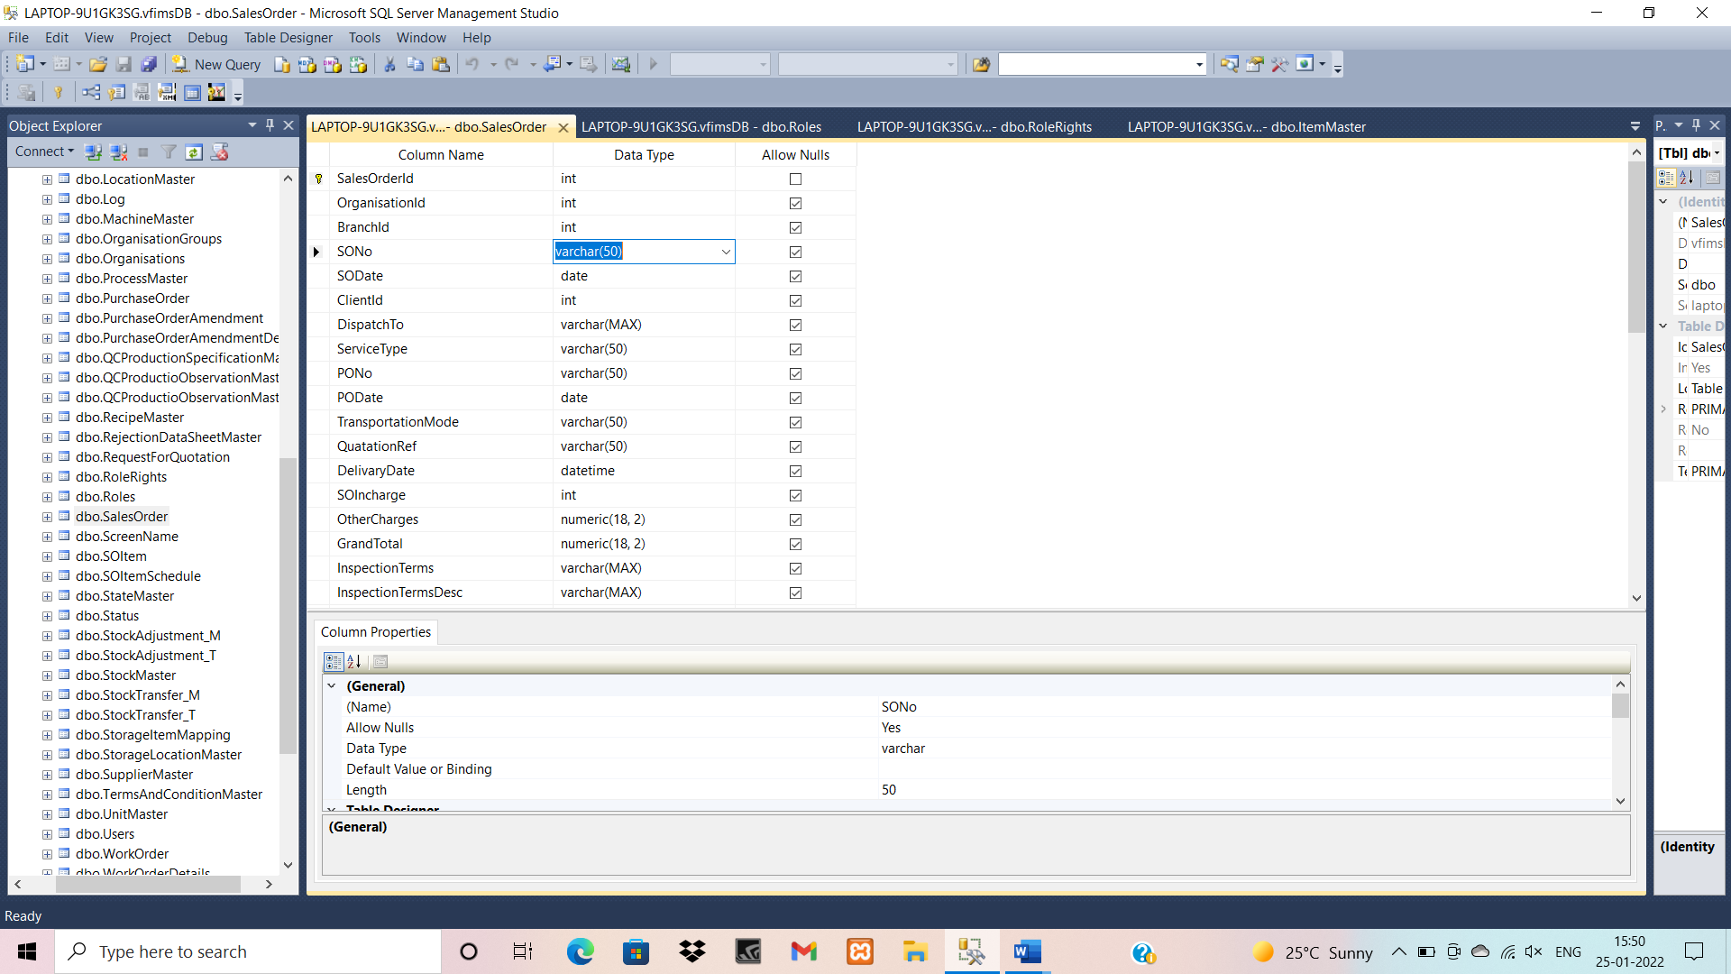
Database Design

Slide 8
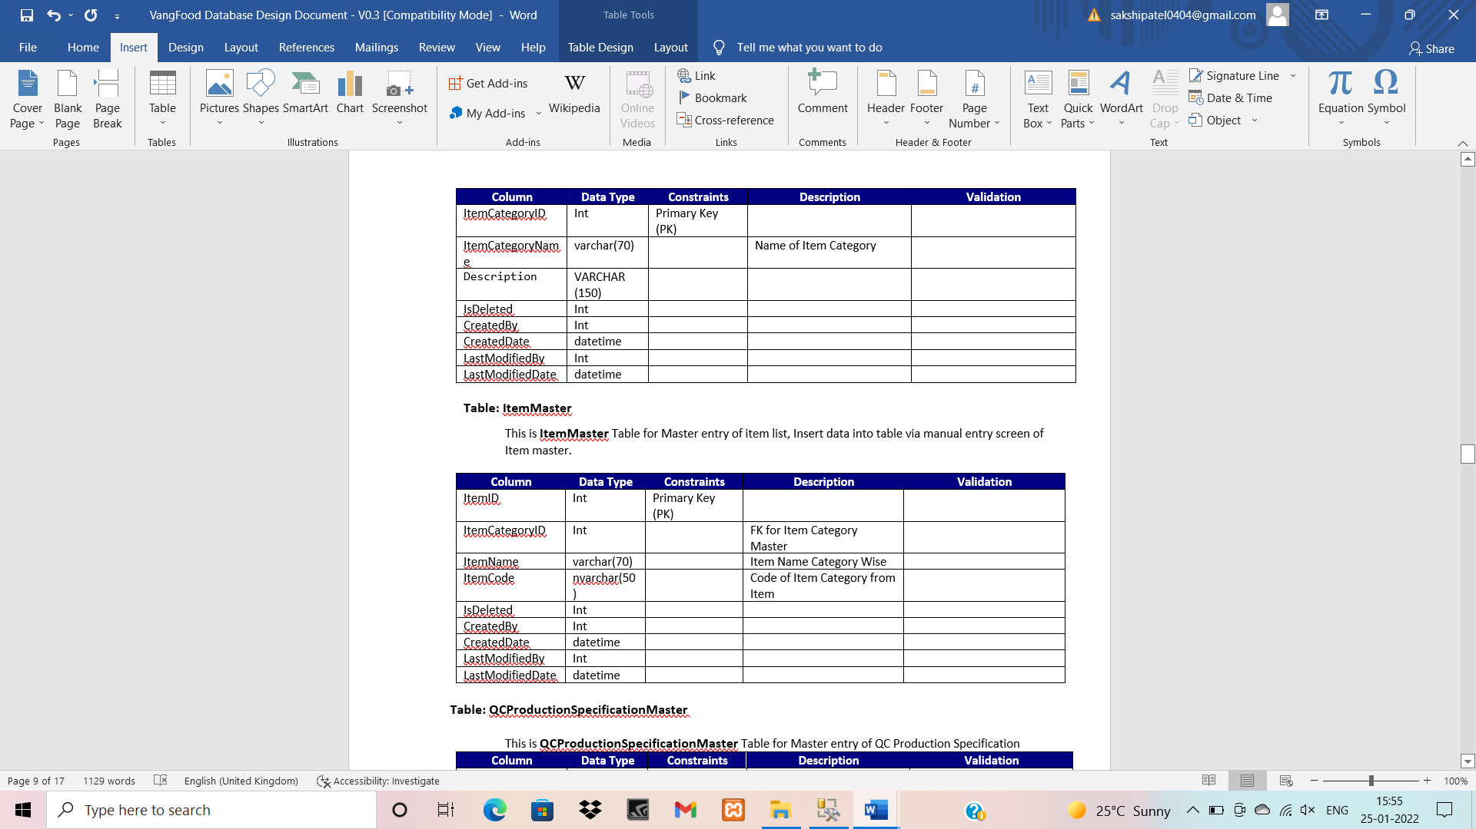
Documentation

Slide 9
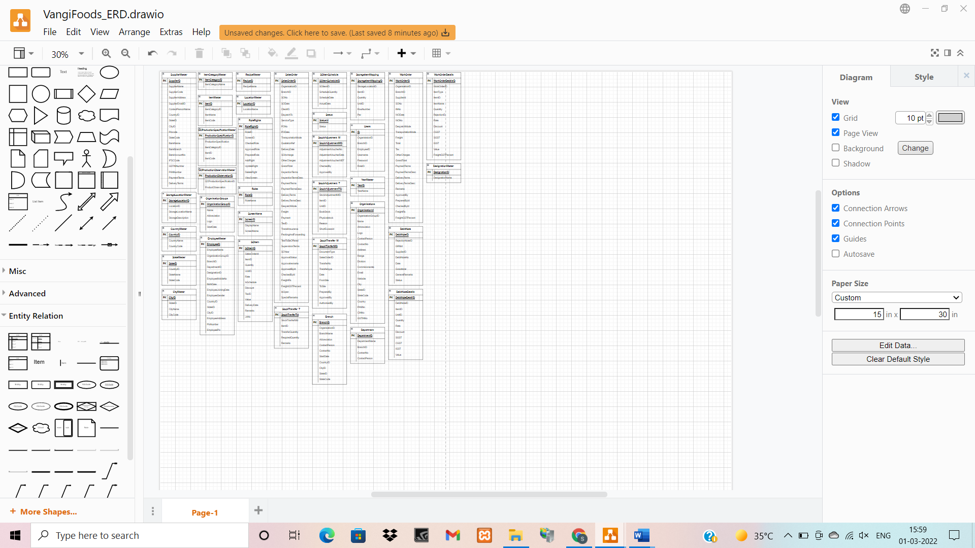
Entity Relationship Diagram [ERD]

Slide 10
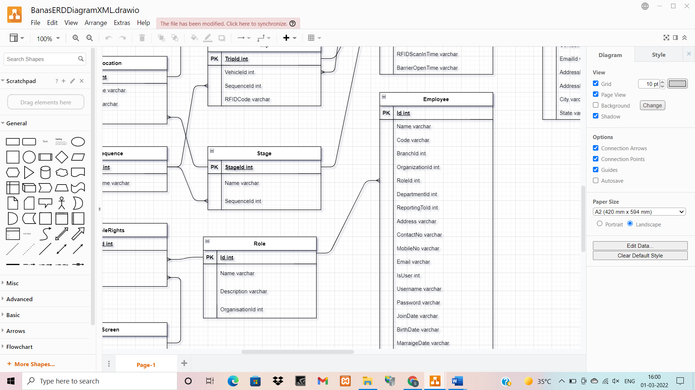

Slide 11
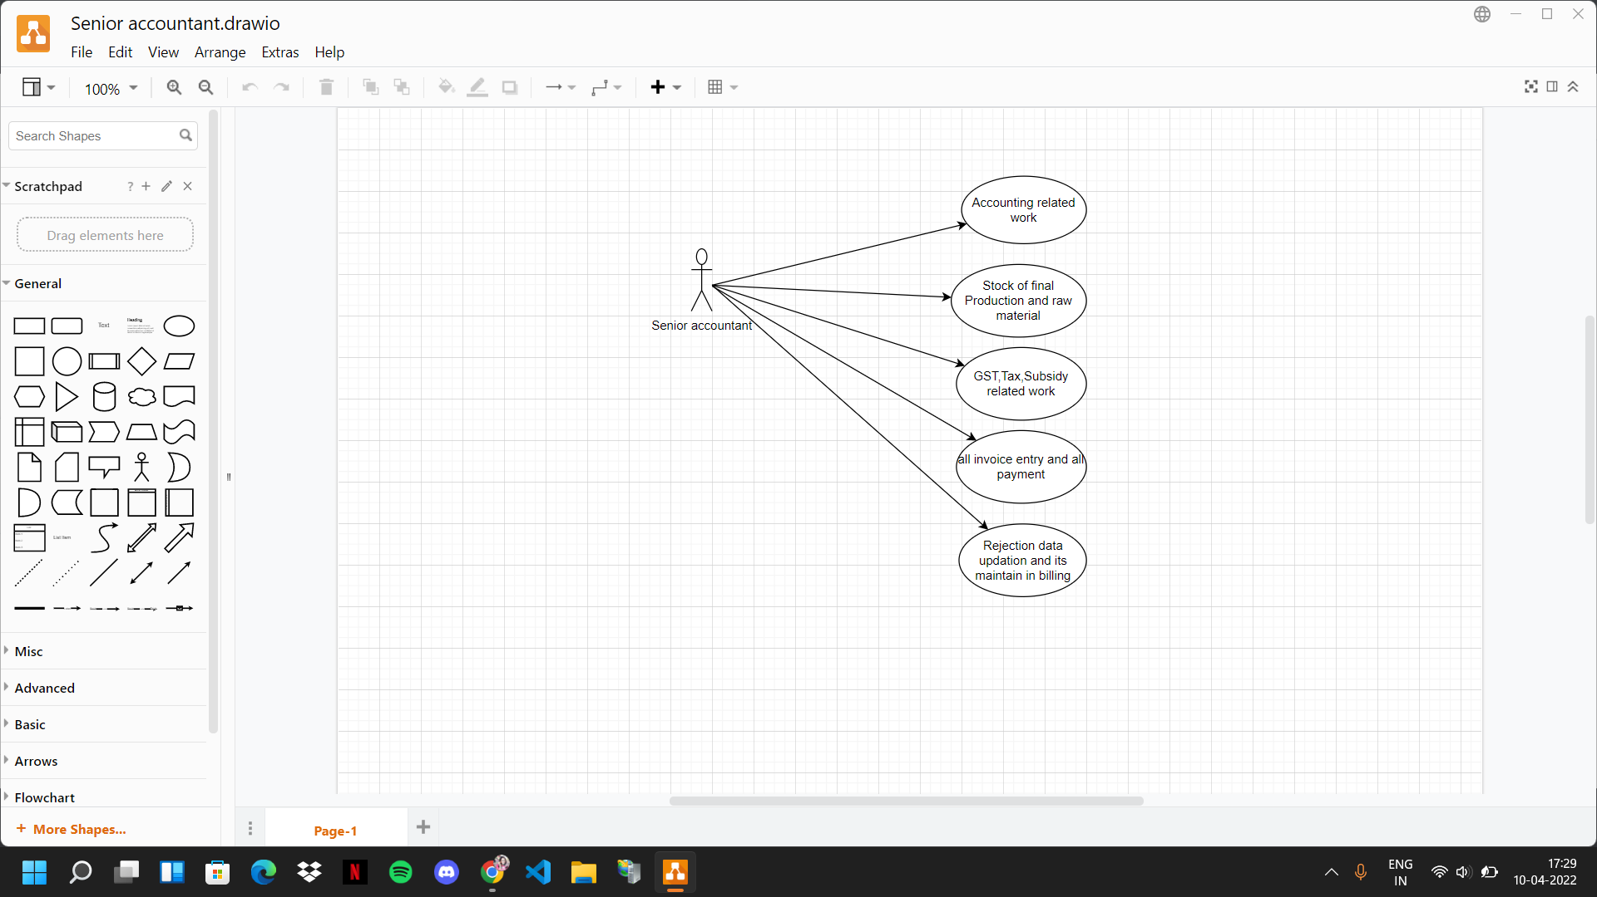
UX-Use Case Diagram

Slide 12
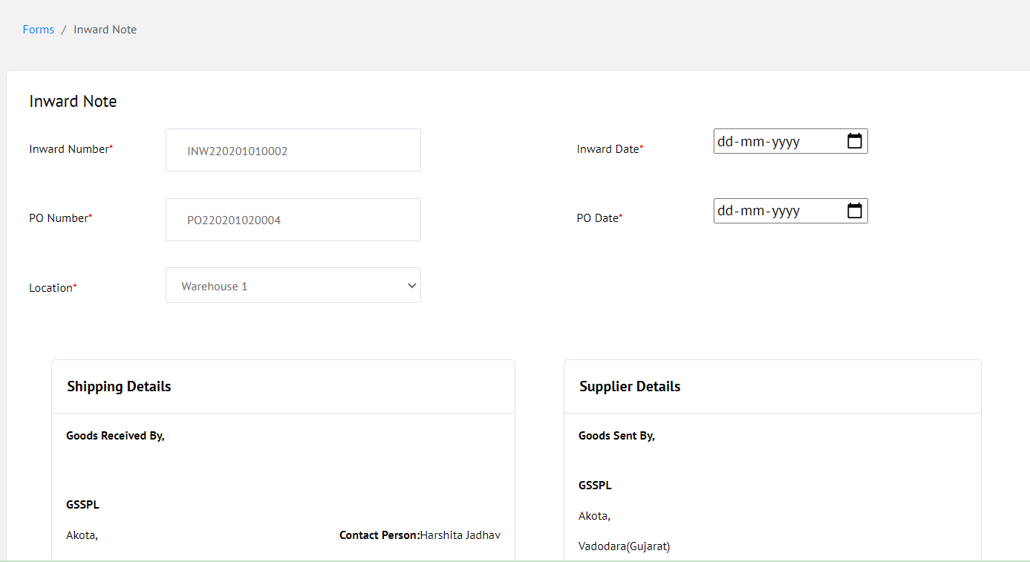
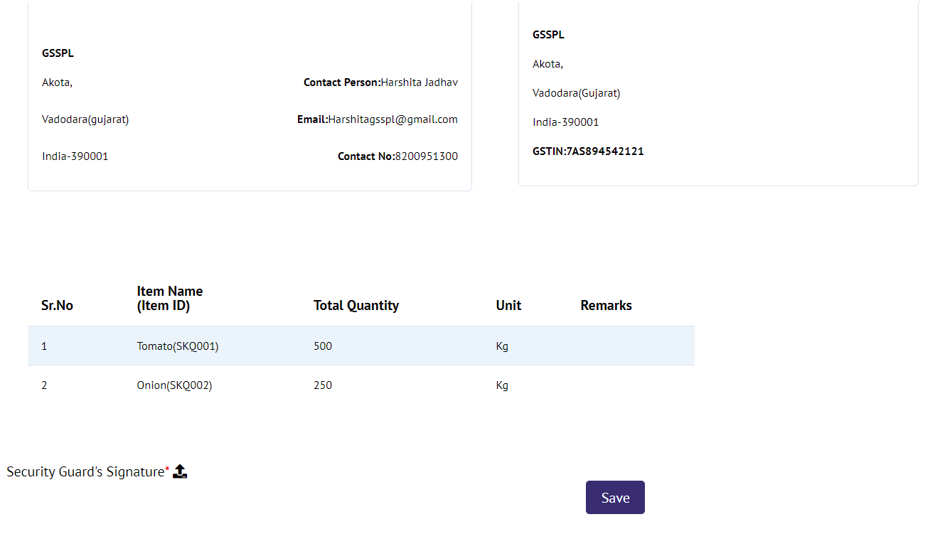
Screen Designing

Slide 13
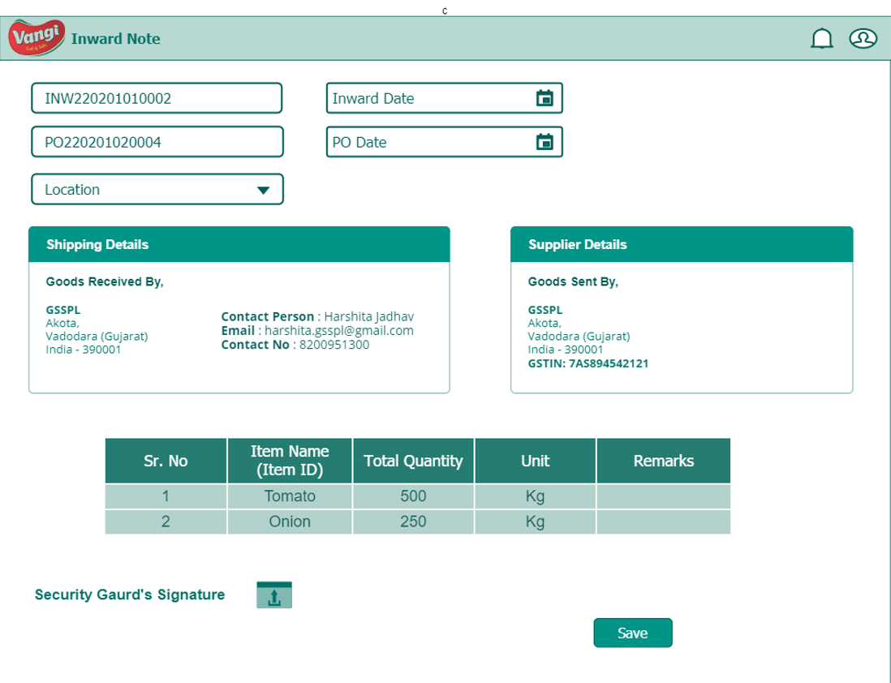
Corresponding Wireframe

Slide 14
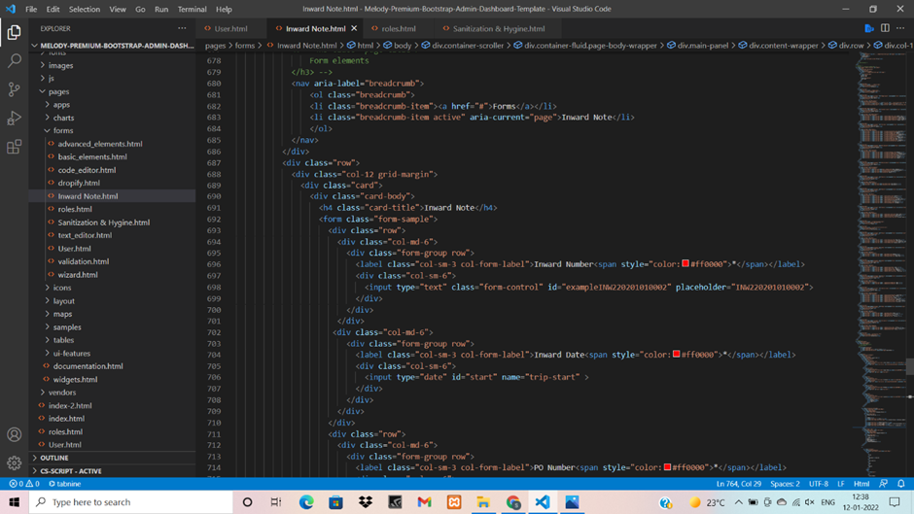
Code

Slide 15
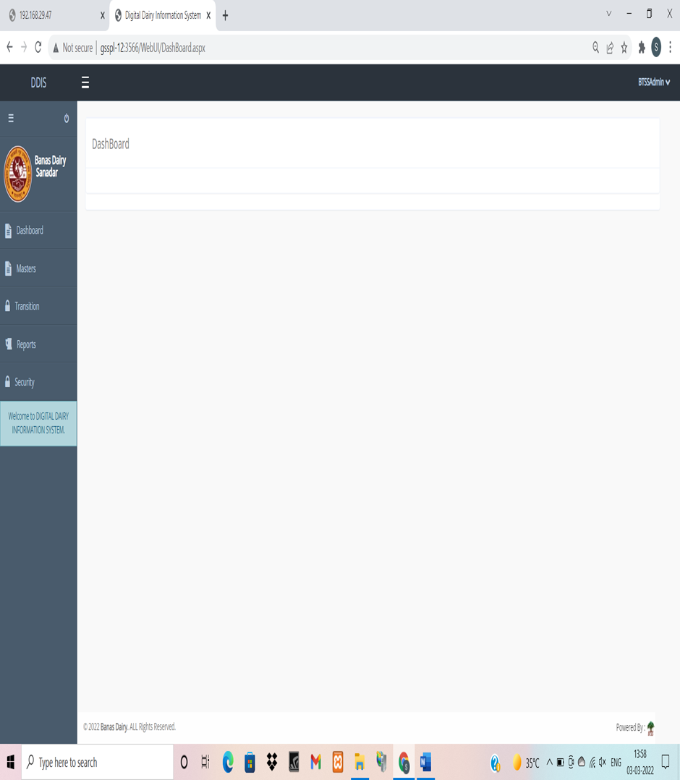
Testing & Debugging

Slide 16
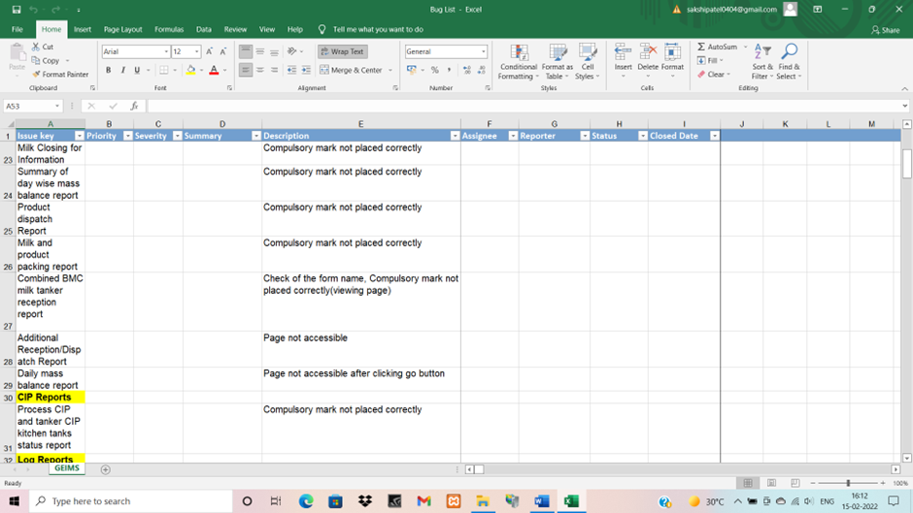
Test Bug List

Slide 17
My Learnings from the Internship
Gaining work experience
Developing and refining Technical skills
Exploring the industry and career path
Developing Soft Skills
Networking with professionals in the field
Gaining confidence

Slide 18
Thank You!

